Slide 1
Luke 2: 25-35
25Now there was a man in Jerusalem called Simeon, who was righteous and devout. He was waiting for the consolation of Israel, and the Holy Spirit was upon him. 26It had been revealed to him by the Holy Spirit that he would not die before he had seen the Lord's Christ. 27Moved by the Spirit, he went into the temple courts. When the parents brought in the child Jesus to do for him what the custom of the Law required, 28Simeon took him in his arms and praised God, saying: 29"Sovereign Lord, as you have promised, you now dismiss your servant in peace.

Slide 2
Luke 2: 25-35
30For my eyes have seen your salvation, 31which you have prepared in the sight of all people, 32a light for revelation to the Gentiles and for glory to your people Israel." 33The child's father and mother marveled at what was said about him. 34Then Simeon blessed them and said to Mary, his mother: "This child is destined to cause the falling and rising of many in Israel, and to be a sign that will be spoken against, 35so that the thoughts of many hearts will be revealed. And a sword will pierce your own soul too."

Slide 3
Characters of Christmas
Ordinary People with Extraordinary Roles
Sue de Pyle - Simeon
Luke 2:25-35

Slide 4
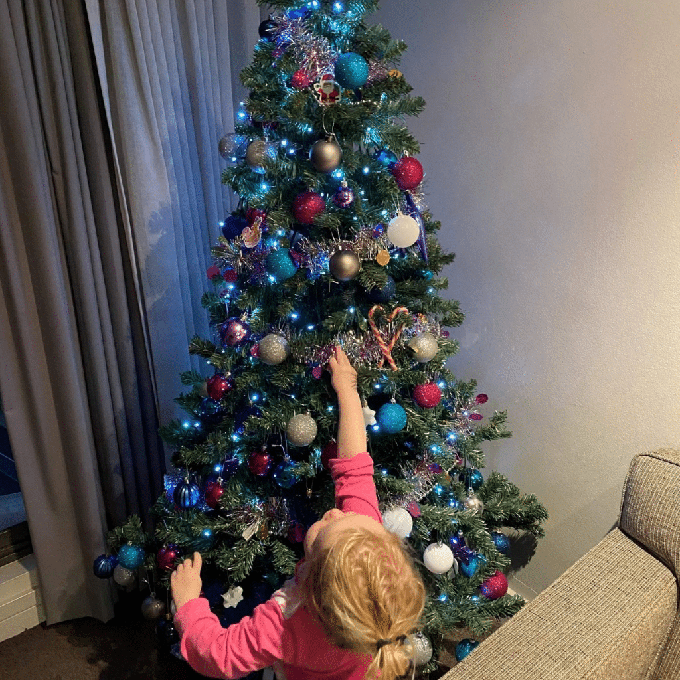
A 1980s Christmas Tale

Slide 5
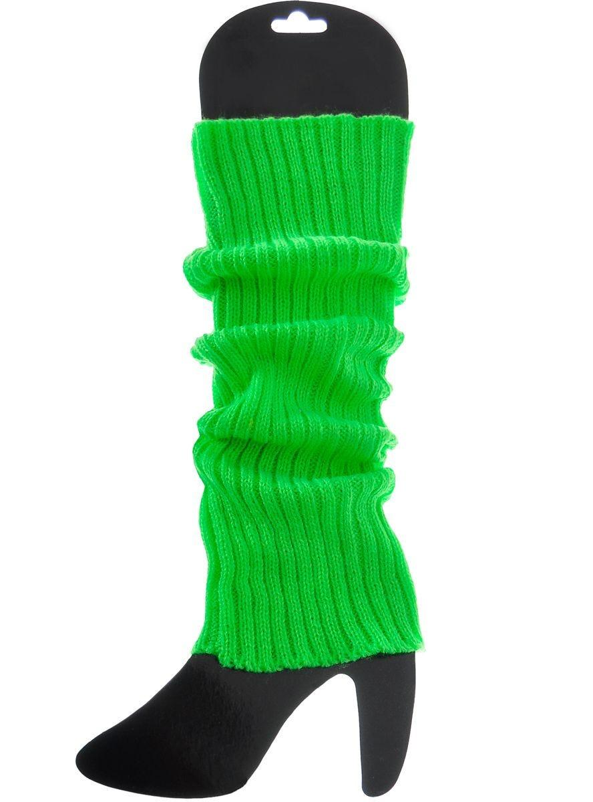
A 1980s Christmas Tale

Slide 6
Simeon
Luke 2
²⁵ Now there was a man in Jerusalem called Simeon, who was righteous and devout. He was waiting for the consolation of Israel, and the Holy Spirit was on him. ²⁶ It had been revealed to him by the Holy Spirit that he would not die before he had seen the Lord’s Messiah.

Slide 7
Simeon
Luke 2
²⁷ Moved by the Spirit, he went into the temple courts. When the parents brought in the child Jesus to do for him what the custom of the Law required,

Slide 8
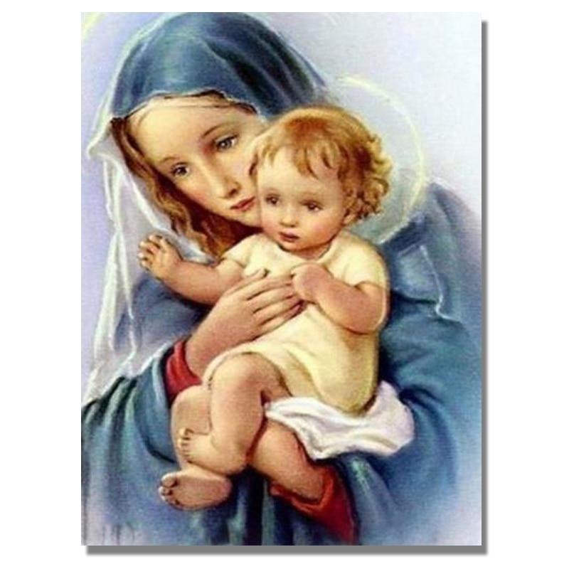
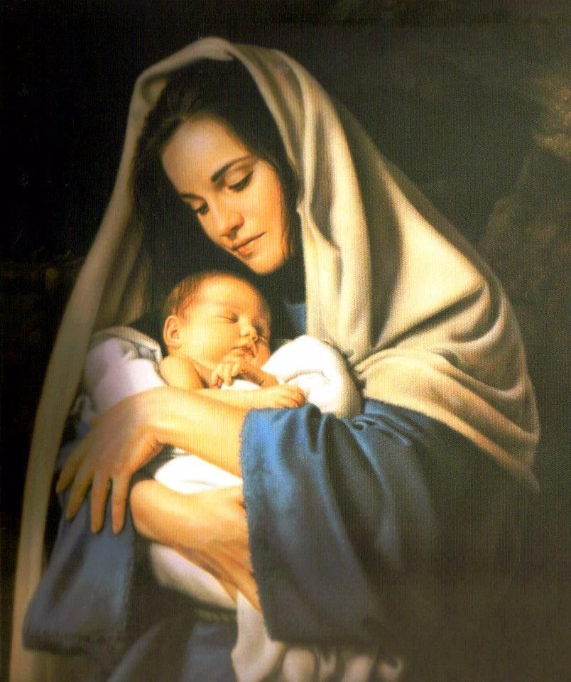

Slide 9
Simeon
Luke 2
²⁸ Simeon took him in his arms and praised God, saying:
²⁹ “Sovereign Lord, as you have promised, you may now dismiss your servant in peace. ³⁰ For my eyes have seen your salvation, ³¹ which you have prepared in the sight of all nations: ³² a light for revelation to the Gentiles, and the glory of your people Israel.”

Slide 10
Simeon
Luke 2
³³ The child’s father and mother marveled at what was said about him. ³⁴ Then Simeon blessed them and said to Mary, his mother: “This child is destined to cause the falling and rising of many in Israel, and to be a sign that will be spoken against, ³⁵ so that the thoughts of many hearts will be revealed. And a sword will pierce your own soul too.”

Slide 11
Simeon
Luke 2:25-35
What can we learn from the story of Simeon?
God keeps His promises
The Holy Spirit guides
Jesus – Humanity and Divinity
Recognise Jesus is the greatest gift of all

Slide 12
Simeon
Luke 2:25-35
Our Challenge
Trust in God’s promises
Listen for the leading of the Holy Spirit and act
Find comfort that Jesus understands our challenges
Acknowledge Jesus’ divinity
Accept the gift of salvation

